Slide 1
Cornerstone City Church Peninsula Plus Community Hoo Are Ya
21st December 2025

Slide 2


Slide 3
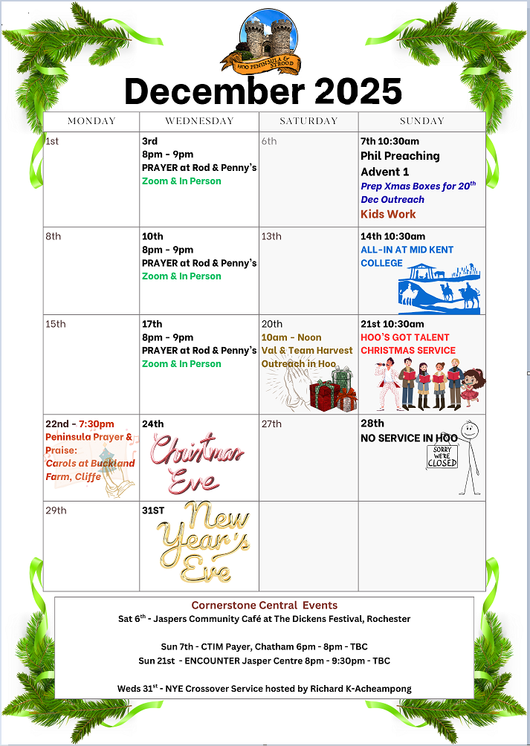

Slide 4
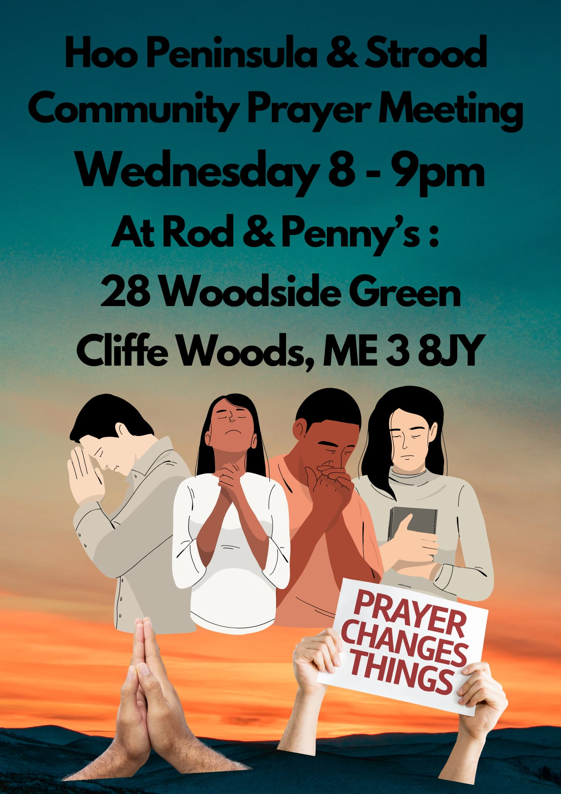

Slide 5
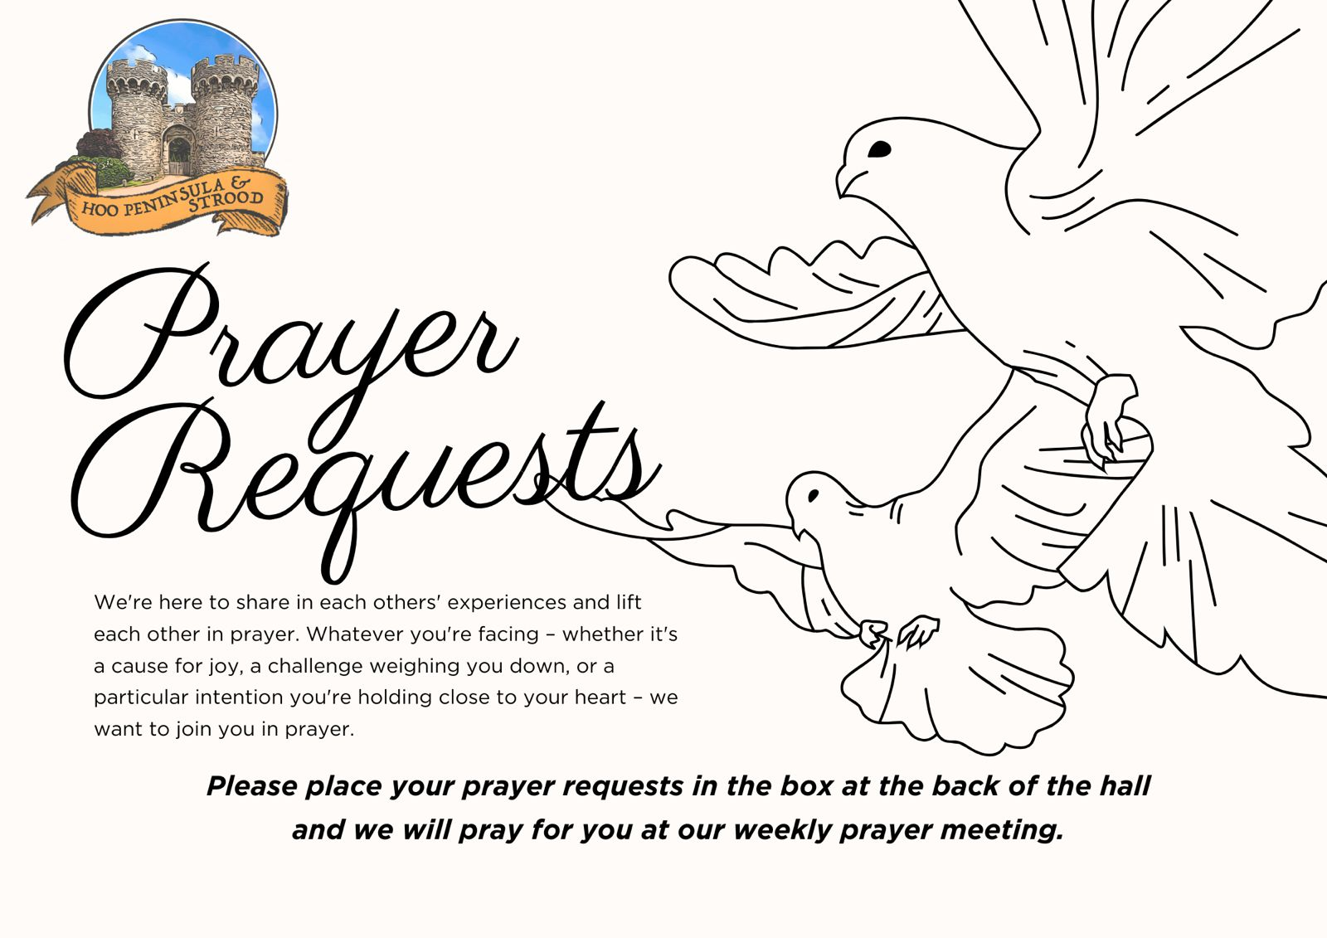

Slide 6


Slide 7
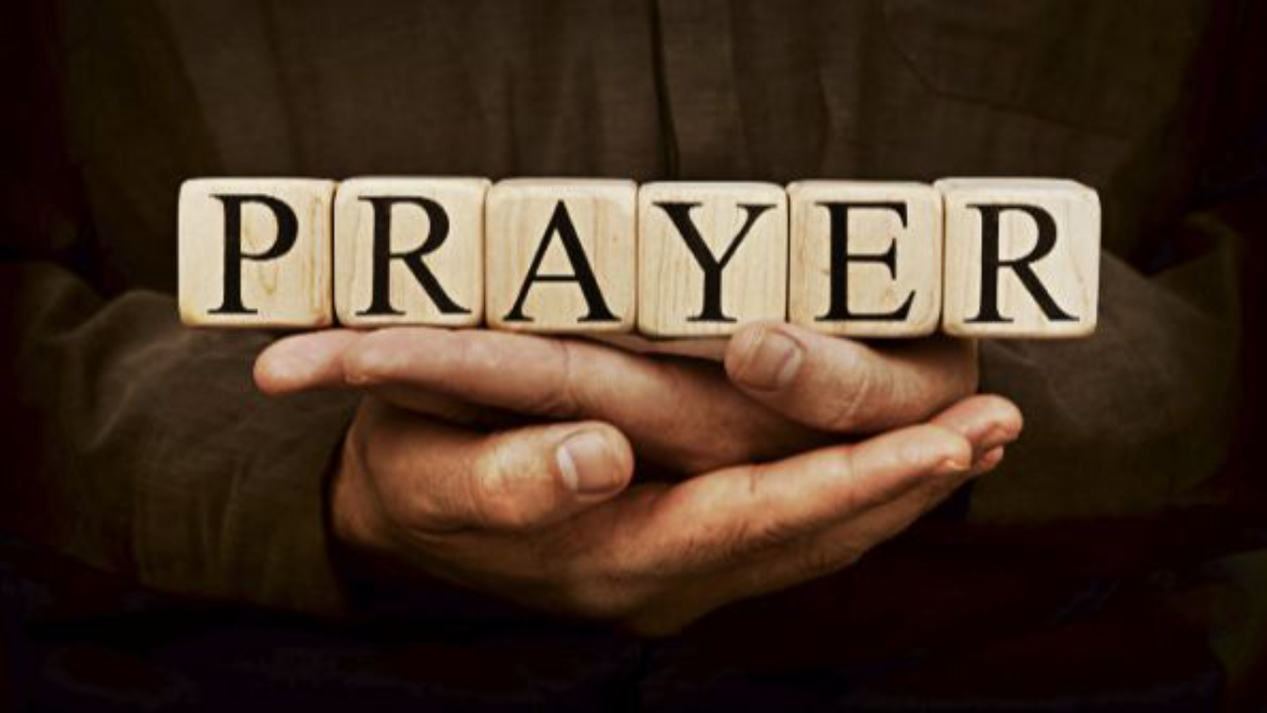

Slide 8
Joy To The World
CCLI Song # 7100235
George Frideric Handel | Isaac Watts | Joth Hunt
© 2017 Planetshakers Ministries Int. Inc.
For use solely with the SongSelect® Terms of Use. All rights reserved. www.ccli.com
CCLI License # 33265

Slide 9
1/3
Joy to the world the Lord has come
Let earth receive her King
Let ev'ry heart prepare Him room
And heaven and nature sing
And heaven and nature sing
And heaven heaven and nature sing

Slide 10
2/3
Joy to the world the Saviour reigns
Let men their songs employ
While fields and floods rocks hills and plains
Repeat the sounding joy
Repeat the sounding joy
Repeat repeat the sounding joy

Slide 11
3/3
He rules the world with truth and grace
And makes the nations prove
The glories of His righteousness
And wonders of His love
And wonders of His love
And wonders and wonders of His love

Slide 12
Angels (Glory To God)
Phil Wickham

Slide 13
1/10
Glo - o-o-o-o o-o-o-o o-o-o-o - ria
Glo - o-o-o-o o-o-o-o o-o-o-o - ria

Slide 14
2/10
Angels we have heard on high
Sweetly singing o'er the plains
And the mountains in reply
Echoing their joyous strains

Slide 15
3/10
Glo - o-o-o-o o-o-o-o o-o-o-o - ria
In excelsis Deo

Slide 16
4/10
Shepherds why this jubilee?
Why your joyous strains prolong?
What the gladsome tidings be
Which inspire your heav’n - ly song?

Slide 17
5/10
Glo - o-o-o-o o-o-o-o o-o-o-o - ria
In excelsis Deo
(REPEAT)

Slide 18
6/10
Glory to God! Glory to God!
Glory to God in the highest forever!
For all He has done, His unfailing love
Glory to God in the highest forever!

Slide 19
7/10
Come to Bethlehem and see
Him Whose birth the angels sing
Come, adore on bended knee
Christ the Lord, the new – born King

Slide 20
8/10
Glo - o-o-o-o o-o-o-o o-o-o-o - ria
In excelsis Deo
(REPEAT)

Slide 21
9/10
Glory to God! Glory to God!
Glory to God in the highest forever!
For all He has done, His unfailing love
Glory to God in the highest forever!
(REPEAT)

Slide 22
10/10
Gloria! Gloria!
Glory to God in the highest
(REPEAT)

Slide 24
O Little Town Of Bethlehem
CCLI Song # 7271589
Ben Trigg | Phillips Brooks
© Words: Public Domain; Music: 2024 Eagle Heights Music
For use solely with the SongSelect® Terms of Use. All rights reserved. www.ccli.com
CCLI Licence No. 33265

Slide 25
1/4
O little town of Bethlehem
How still we see thee lie
Above thy deep and dreamless sleep
The silent stars go by
Yet in thy dark streets shineth
The everlasting Light
The hopes and fears of all the years
Are met in thee tonight

Slide 26
2/4
For Christ is born of Mary
And gathered all above
While mortals sleep
The angels keep their watch of wondering love
O morning stars together
Proclaim the holy birth
And praises sing to God the King
And peace to men on earth

Slide 27
3/4
How silently how silently
The wondrous gift is given
So God imparts to human hearts
The blessings of His heaven
No ear may hear His coming
But in this world of sin
Where meek souls will receive Him still
The dear Christ enters in

Slide 28
4/4
O holy Child of Bethlehem
Descend to us we pray
Cast out our sin and enter in
Be born in us today
We hear the Christmas angels
The great glad tidings tell
O come to us abide with us
Our Lord Emmanuel

Slide 30
Hope Has A Name CCLI Song # 7163645
Jacob Sooter | Kristian Stanfill | Sean Curran
© 2020 Capitol CMG Paragon; KPS 1.0; sixsteps Music; sixsteps Songs; Sounds Of Jericho; worshiptogether.com songs; Just When Publishing; So Essential Tunes
For use solely with the SongSelect® Terms of Use. All rights reserved. www.ccli.com
CCLI Licence No. 33265

Slide 31
1/6
Breaking through the silence
With glory in the highest
The hope of all creation
Resting in his mother's arms

Slide 32
2/6
A song on the horizon
Ringing through the heavens
The long-awaited Savior
Come to set the captives free
Come to set the captives free
Come set us free

Slide 33
3/6
Hope has a name
Emmanuel
The Light of the World
Who broke through the darkness
All hail the King
Emmanuel
The Light of the World
The Glory of Heaven

Slide 34
4/6
We didn't see it coming
The story of redemption
What started in a manger
Ended in an empty grave
Oh I know that

Slide 35
5/6
Come if you're broken
Come if you're searching
If you need healing
He's where you find it
Lay down your burdens
And breathe in forgiveness
If you need freedom
He's where you find it

Slide 36
6/6
Hope has a name
Emmanuel
The Light of the World
Who broke through the darkness
All hail the King
Emmanuel
The Light of the World
The Glory of Heaven

Slide 37


Slide 38
Hoos Got Talent Program
1. Richard Intro (5 mins)
2. Aliyah, Toni and Dele (10 mins)
3. Jamin (10 mins)
4. Wilfried (10 mins)
5. Jasiel (10 mins)
6. Adam and Dele (10 mins)
7. Cheryl (10 mins)
8. Parveen (10 mins)
9. Stacey (15 mins)

Slide 39
2 Corinthians 14 May the grace of the Lord Jesus Christ, and the love of God, and the fellowship of the Holy Spirit be with us all. And….
Surely goodness and mercy shall follow us all the days of our lives, and we shall dwell in the house of the Lord forever.

